Slide 1
Amazon Customer Satisfaction Sentiment Analysis
Avinash Bondalapati
Krishna Mani Teja Katragadda
Notes:
Good Afternoon

Slide 2
contents
Problem statement
Motivation
Data
Map-reduce
results
Technology stack / additional packages
Next steps

Slide 3
The Problem
identification of the customer satisfaction across various product categories of amazon by analysing the individual product reviews in various product categories.
Observe whether in the sales are good or bad in a category.
Notes:
With the help of product reviews.
Analyse the performance of category.

Slide 4
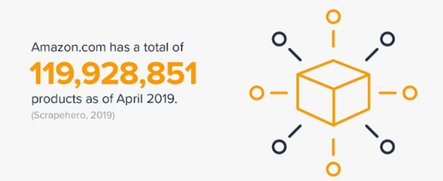
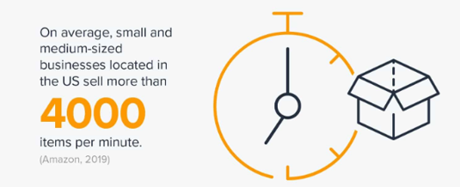

motivation
With the increasing sales on E-Commerce websites, it becomes difficult to understand the data and interpret if the customer satisfaction is positive or negative across the various product categories with multiple product reviews.
Notes:
Shift of people from Traditional to Online shopping
In order to be in Competition, # of product are included increased.
Whole foods was bought by Amazon
To track service quality-- Customer satisfaction is needed.

Slide 5

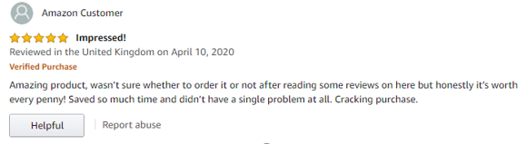
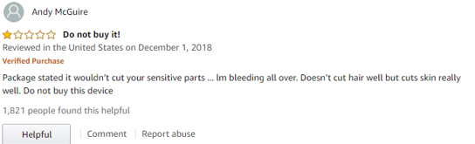
motivation
Understanding the performance of a category is not possible by looking at reviews alone.
Companies like Amazon build Amazon Warehouses which delivers items backed by standard return policies.
Customer satisfaction leads to customer retention.
Notes:
Product review can be confusing.
Amazon(e commerce ) aim is to analyse the performance of category not individual product
20% and 80% example.
Amazon tracks category performance mainly not product performance

Slide 6
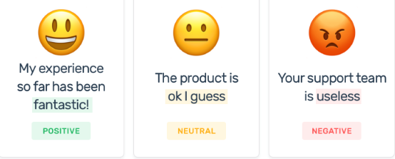
Baseline idea
Obtain a sentimental value for each review of the product.
Combine the sentimental value for each product category.
Project the final Sentimental value for each product in an easier way to understand.

Slide 7
Data
1. We chose 12 categories for this project and they are listed beside.
2.We chose only 4% of the entire data that we sourced. But the 4% of data accounts to nearly “3.1 million” records
Apparel
Automotive
Books
Camera
Electronics
Health Personal care
Home Entertainment
Major Appliances
Music
Office Products
Personal Care Appliances
Watches
Notes:
Data that we utilized 4% of sourced data which sums up to be around 3.1 million.
Run time: 30 mins.

Slide 8
Data continued...
1.The data we used is in tab separated format with columns listed beside
2.Each record has a value called review_body which we used to calculate the polarity.
Marketplace
Customer_id
Review_id
Product_id
Product_parent
Product_title
Product_category
Star_rating
Helpful_votes
Total_votes
Vine
Verified_purchase
Review_headline
Review_body
Review_date
Notes:
Review_Body

Slide 9
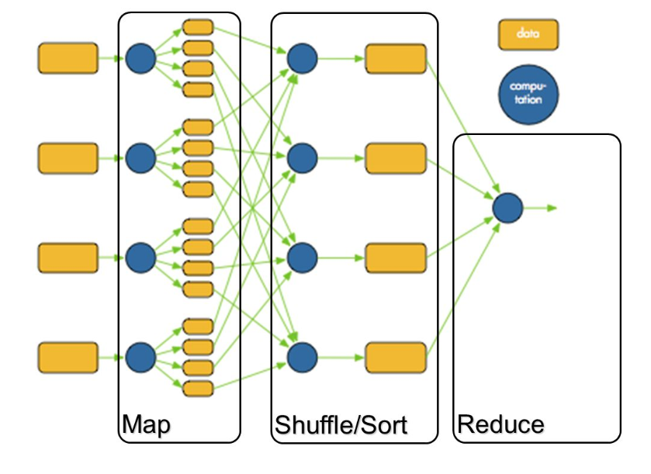

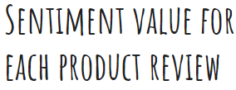
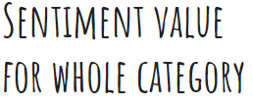
After calculating the polarity value of each of the review body we try to find the total count of negative, neutral and positive reviews for each of the categories.
For our second calculation, we find the distinct customer_id and then find the count of negative, neutral and positive reviews provided by them.
Notes:
So coming for the implementation part of our project. Our Initial idea was to find the sentiment value of each record and then aggregate those record per category and then calculate the sentiment value for that category.
So after calculating the sentiment value for each individual record and then aggregating those values, we have applied some transformations on the RDD to get results such as Top 20 reviewers and top 20 products based on positive reviews count.
As Krishna stated, we have used around 3.1 million records for our project. One reason to use this much of a larger dataset is to see how system behaves when try to overwhelm the system with data and what sort of behaviour is seen when we run datasets larger than system memory.

Slide 10
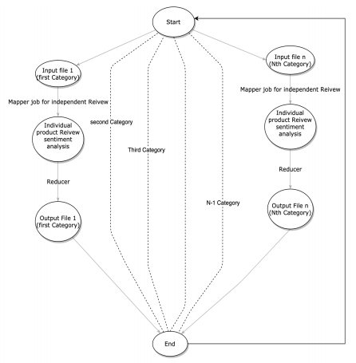
Initial Idea:
first, compute for
one category.
next category
repeat step2
Notes:
Our initial Idea was to serve the program with single file for each category. But with change in the dataset and being moved to a larger data set than expected we thought that it would be beneficial to move to a single dataset with all the records.

Slide 11
Multiple files for the product category have been joined into a single file.
Single_file=cate(1)+cate(2)+.......+cate(n)
Notes:
So as a part of it we have merged all the records from those 12 categories into a single file and used this for the project.
Now lets see what we have used for sentiment calculation.

Slide 12


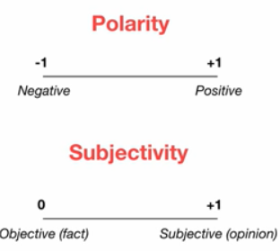
TextBlob
A powerful python library, which is useful in sentiment Analysis.
A TextBlob object takes a string and uses its functions to perform Noun Phrase Extraction,Part-of-speech Tagging and Sentiment Analysis.
The sentiment function of textblob returns two properties, polarity, and subjectivity.
The beer is good -- BEER and GOOD are identified by noun phrase func.
pos
But the hangover is horrible.
neg
Notes:
We wanted to highlight the Big data part of the project. So we reduced the Machine Learning work and introduced TextBlob which is an API provided for the Natural Language Processing to do our sentiment analysis and calculate the polarity..
This being a python package and opensource one. we thought that this would be a good replacement and we dont need to train and test the classifier when compared to machine learning.
Here TextBlob takes care of training and testing the classified. we just need to send the text that we want to analyze. TextBlob analyzes and returns us the polarity value. Using this we can identify if the text is positive, neutral or negative.

Slide 13
Sentiment calculation
To calculate the sentiment value, we have used textblob. This internally uses either a “Pattern Analyzer” or a “Naive Bayes Analyzer”
Based on the input string the polarity value is obtained this gives us the sentiment value of the particular string.
Words such as “Good” and “wonderful” have a positive score and textblob takes care of analyzing the text and then assigns a sentiment value.
We get the count of positive, negative and neutral reviews for a specific category.
Notes:
For the sentiment calculation we have NLTK and textblob as options, textblob provides a much cleaner API for the sentiment analysis. So we have chosen this as our option to calculate the sentiment value.
Textblob takes care of the analysing the text by identifying the words like good and wonderful and ends up at a sentiment value. We use this value returned from textblob to identify if we have a positive, negative and neutral review.

Slide 14
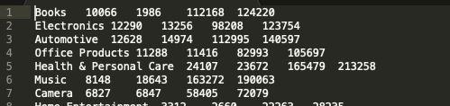
Results till now
Produced 4 different result files as a part of our project. Following is one of the text result.
While the output of these files are text results. To make it easier to understand, we have plotted our results as a graph.
Some of our graphs include - Top 20 products with positive feedback, Top 20 reviewers providing positive feedback and Customer feedback across different product categories.

Slide 15
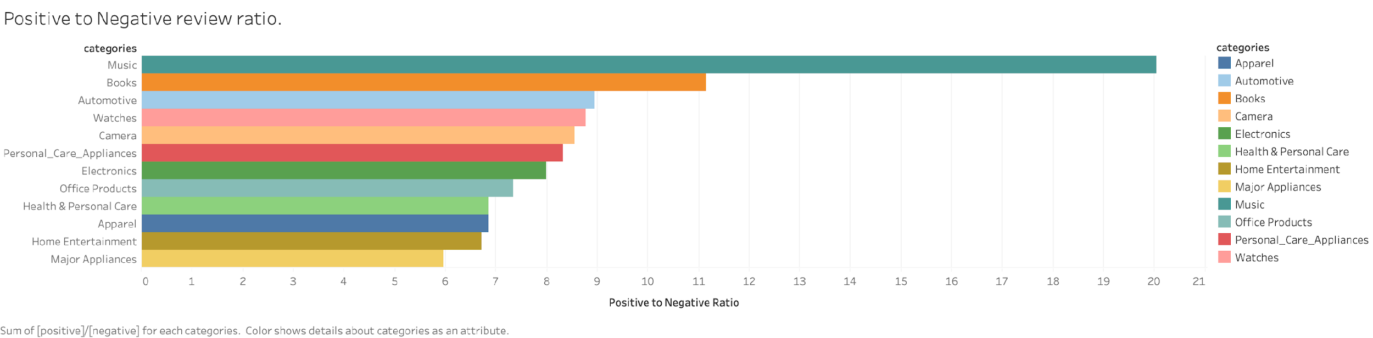

Slide 16
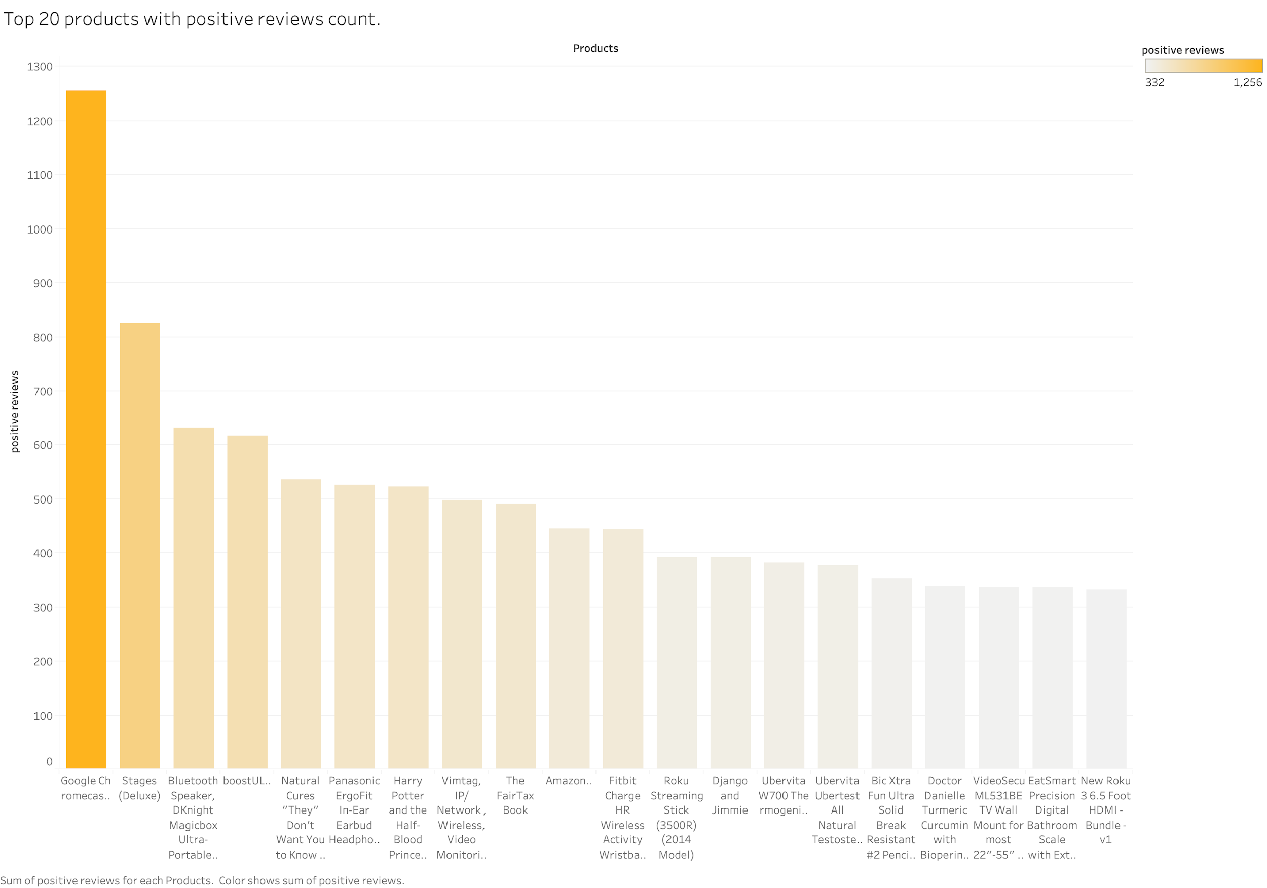

Slide 17
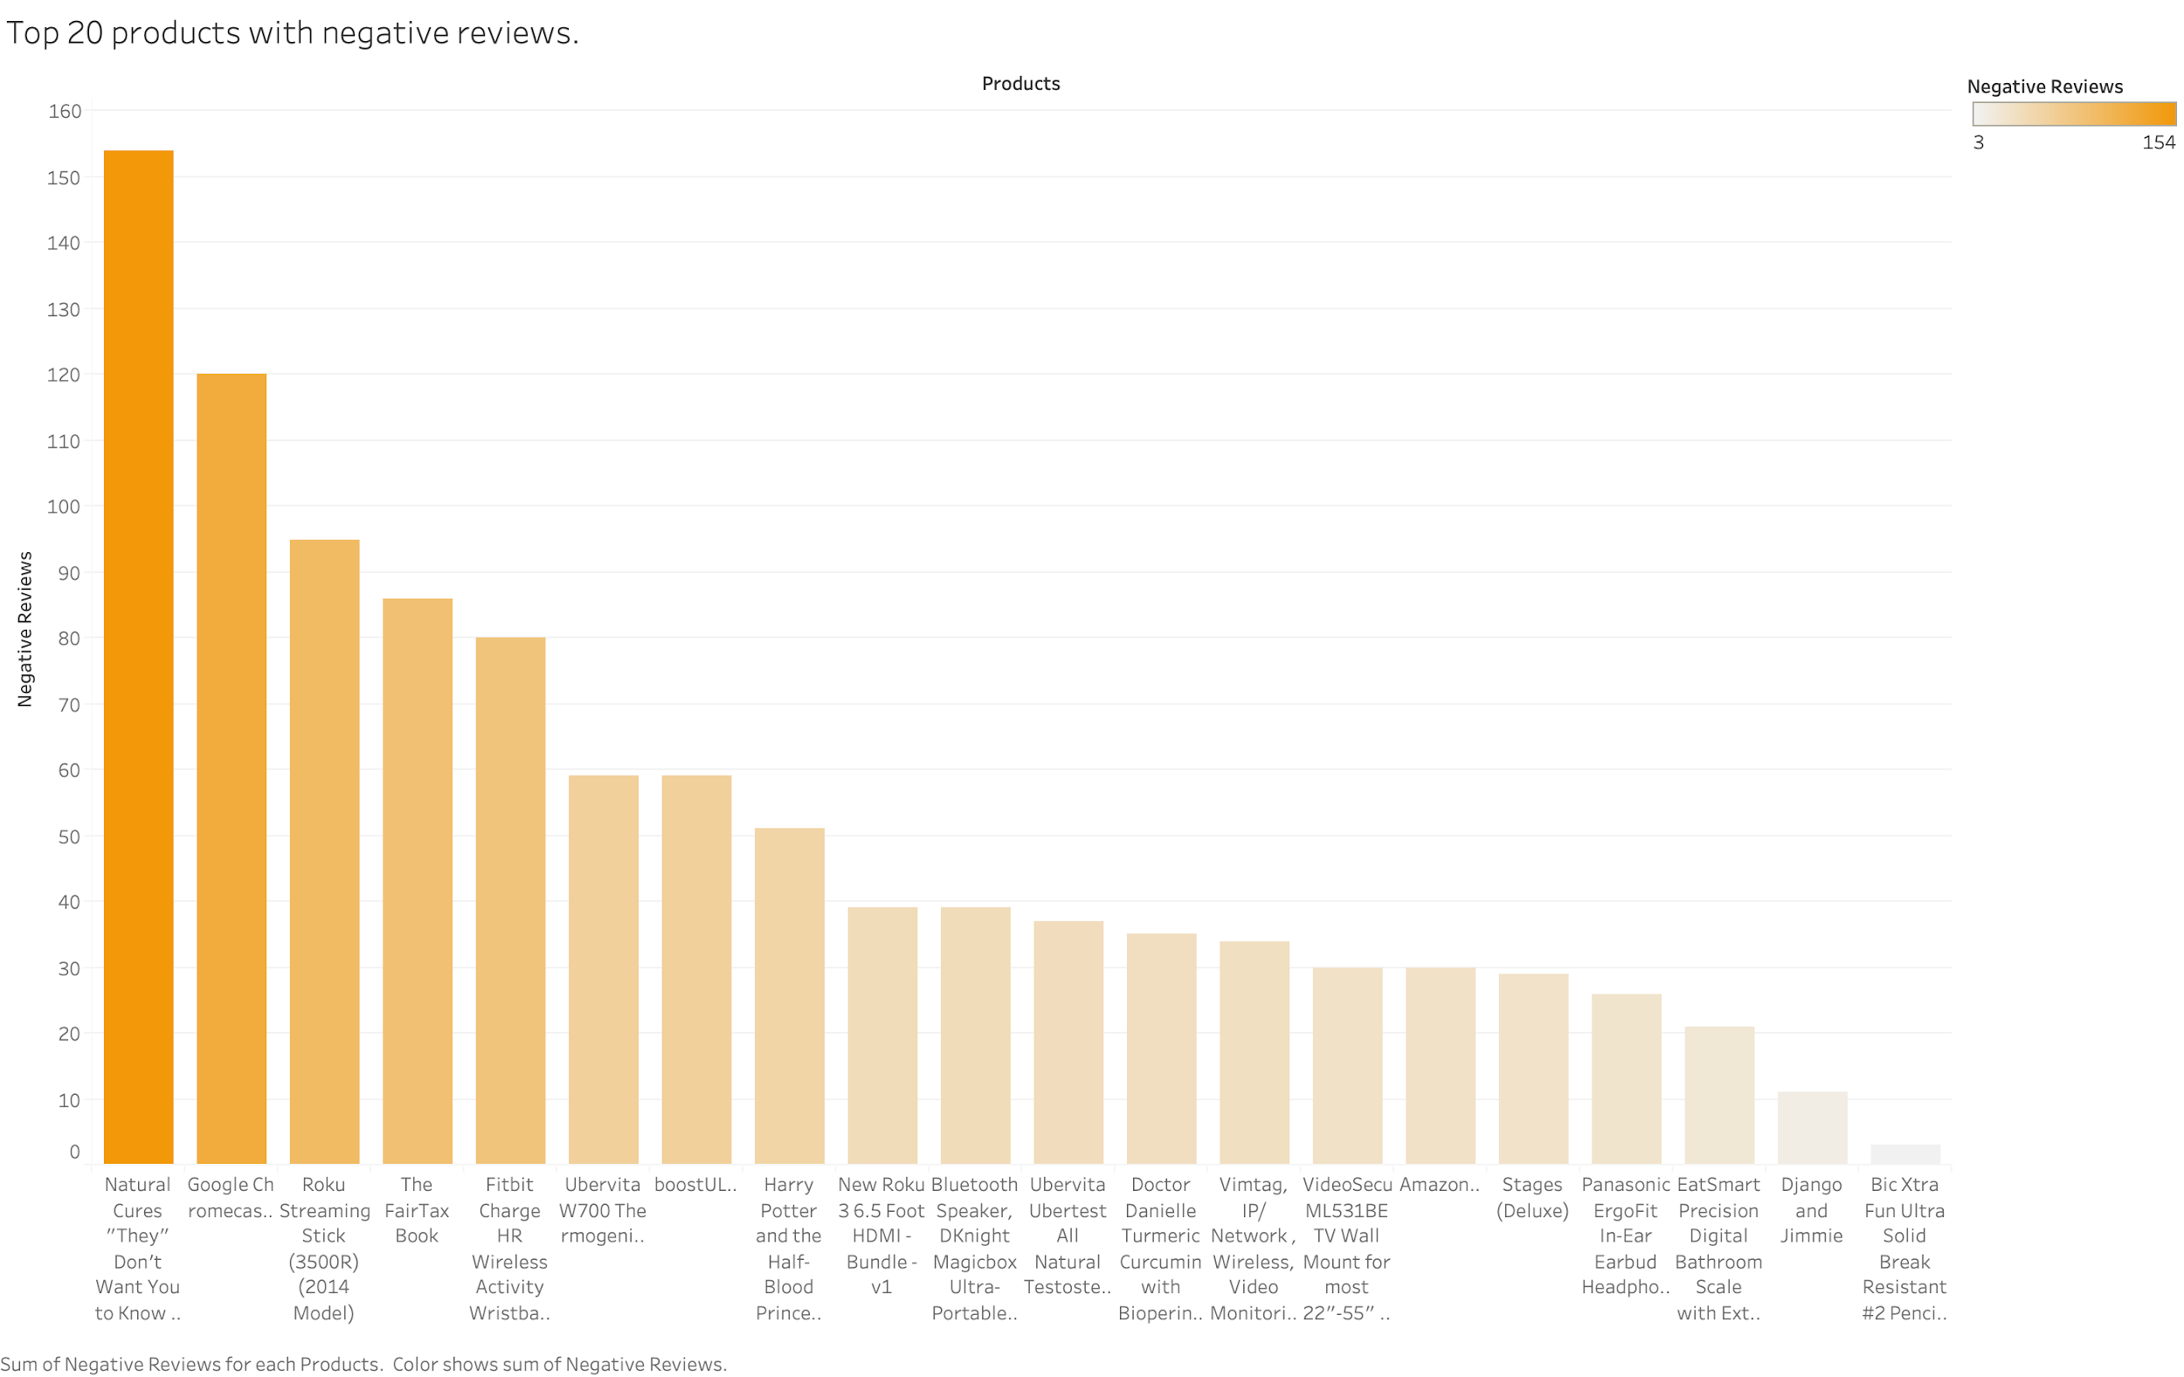

Slide 18
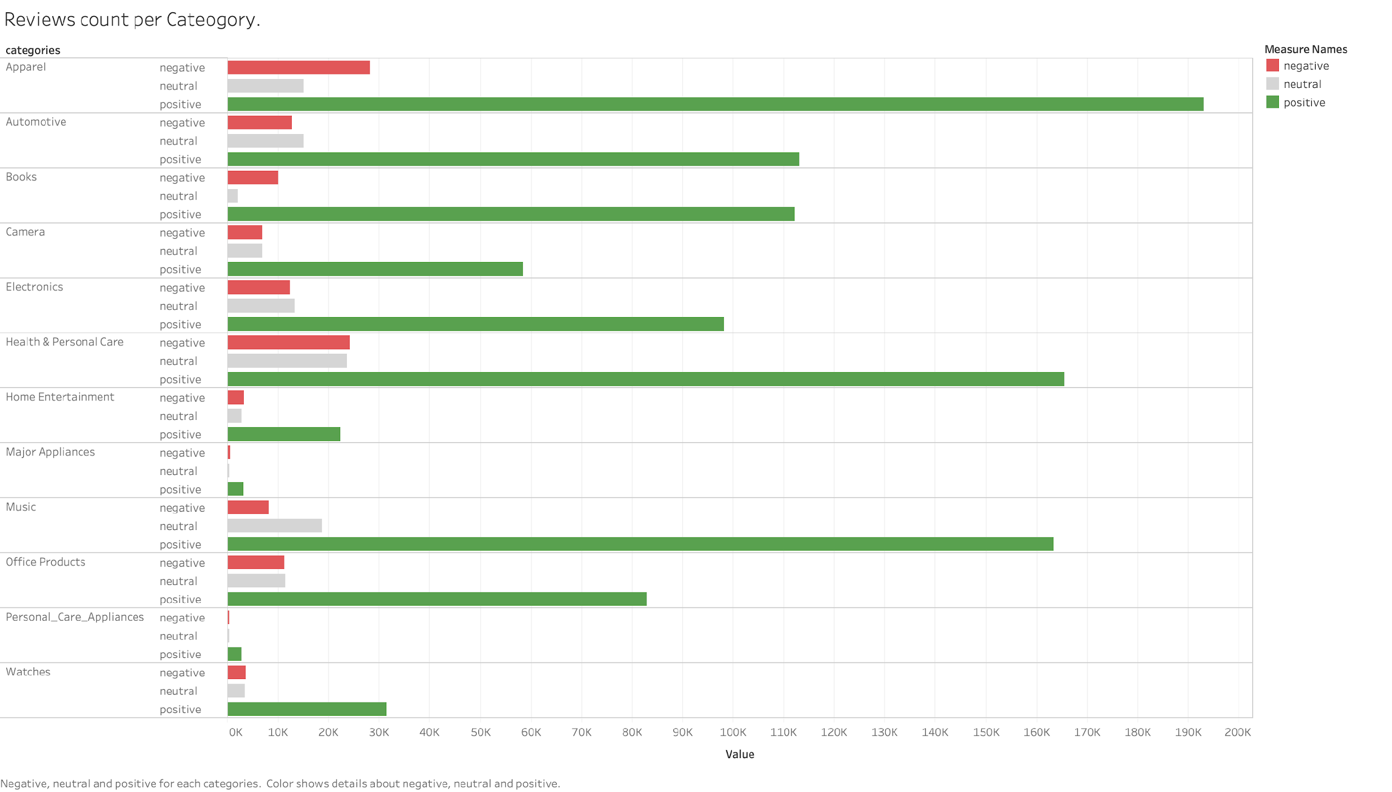

Slide 19
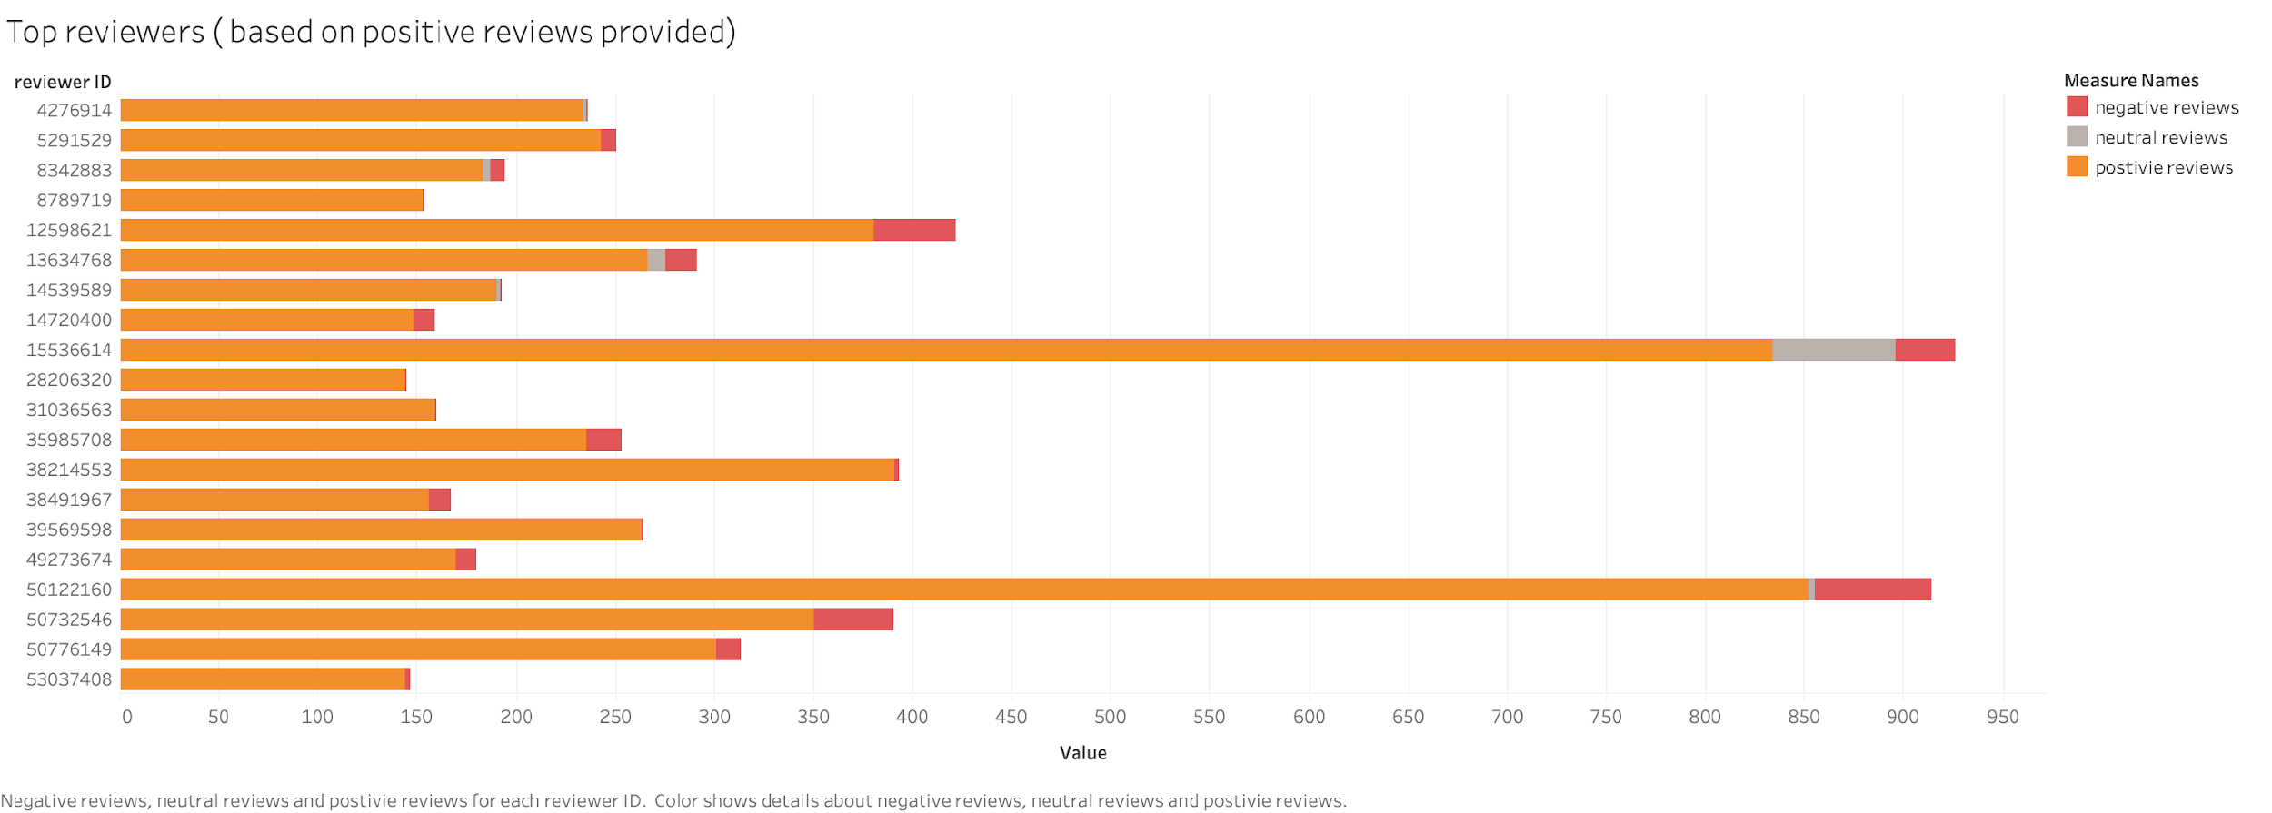

Slide 20
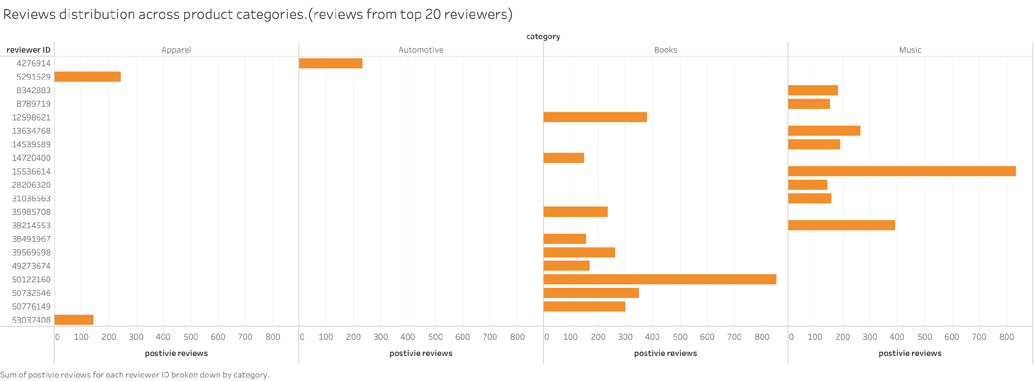

Slide 21
Next steps
We will try to improve the running time by using the Spark ML library
To include other categories and also to run the entire dataset of what we procured.

Slide 22
References
Hota and S. Pathak. Knn classifier based approach for multi-class sentiment analysis of twitter data. In International Journal of Engineering Technology, pages 1372–1375. SPC, 2018
Rain. Sentiment analysis in amazon reviews using prob- abilistic machine learning. Swarthmore College, 2013.
https://s3.amazonaws.com/amazon-reviews-pds/tsv/index.txt

Slide 23
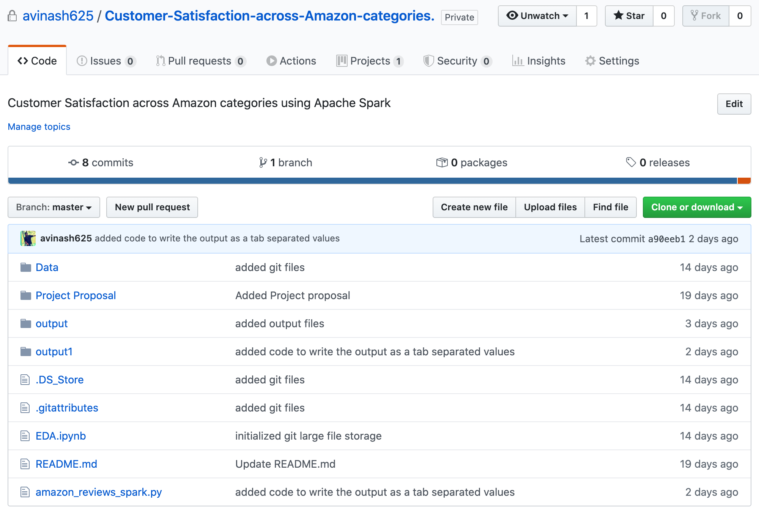
github

Slide 24


